Slide 1
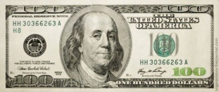
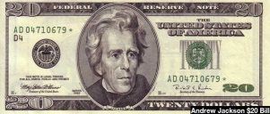
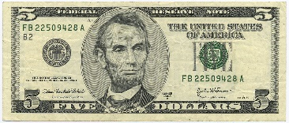




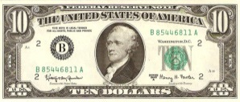

Worcester Township boasts the lowest property tax in Montgomery County. The Township’s property tax is levied at 0.05 mills, and there is no proposed change to this tax in 2021. The owner of a property in Worcester Township that is assessed at $300,000 (the approximate assessment for a house with a market value of $650,000) pays $15 in property tax to the Township. This same owner pays $1,154 in property tax to Montgomery County (3.849 mills), and $9,256 in property tax to the Methacton School District (30.8534 mills).
If you pay property taxes, for every $1,000 paid…
$887.81 is paid to the Methacton School District
$110.75 is paid to Montgomery County
$1.44 is paid to Worcester Township

